Slide 1
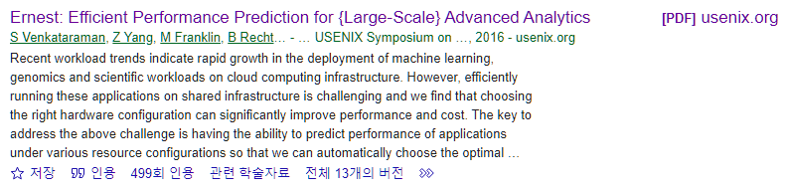
Ernest: Efficient Performance Prediction for Large-Scale Advanced Analytics
Shivaram Venkataraman, Zongheng Yang, Michael Franklin, Benjamin Recht, and Ion Stoica, University of California, Berkeley
13th USENIX Symposium on Networked Systems Design and Implementation (NSDI 16). 2016.
22.11.29.
Cloud Computing
Sohee Kim
Notes:
Venkataraman, Shivaram, et al. "Ernest: Efficient Performance Prediction for {Large-Scale} Advanced Analytics." 13th USENIX Symposium on Networked Systems Design and Implementation (NSDI 16). 2016.
https://www.usenix.org/system/files/conference/nsdi16/nsdi16-paper-venkataraman.pdf
https://www.youtube.com/watch?v=dTfkBkkakOM&t=39s
https://www.slideshare.net/SparkSummit/ernest-efficient-performance-prediction-for-advanced-analytics-on-apache-spark-spark-summit-east-talk-by-shivaram-venkataraman?from_action=save

Slide 2
1. Introduction
Venkataraman, Shivaram, et al. "Ernest: Efficient Performance Prediction for {Large-Scale} Advanced Analytics." 13th USENIX Symposium on Networked Systems Design and Implementation (NSDI 16). 2016.
Workload trends : Advanced Analytics (machine learning, genomics, scientific)
Challenge : predicting the most efficient configuration for large advanced analytics applications in a heterogeneous multi-tenant environments
User’s goal : Minimizing the running time given a budget / Meeting a deadline while minimizing the cost
Performance model
data
Job
Ernest (A performance prediction framework for large scale analytics)
A new approach that can accurately predict the performance of a given analytics job
The main idea is to run a set of instances of the entire job on samples of the input, and use the data from these training runs to create a performance model.
Black box jobs → but works well
Has low overhead (takes much less time and resources to run the training jobs than running the job itself)
Optimal experiment design : statistical technique to select the most useful data points for training
How Ernest can detect when a model isn’t appropriate and how small extensions can be used to model complex workloads
Execution experiments on Amazon EC2 → accurate for a variety of algorithms, input sizes, and cluster sizes.
Notes:
Recent workload trends indicate rapid growth in the deployment of machine learning, genomics and scientific workloads on cloud computing infrastructure.
In this paper, they address the challenge of choosing the configuration to run large advanced analytics applications in heterogeneous multi-tenant environments.
The choice of configuration depends on the user’s goals which typically includes either minimizing the running time given a budget or meeting a deadline while minimizing the cost.
The key to address this challenge is developing a performance prediction framework that can accurately predict the running time on a specified hardware configuration, given a job and its input.
So they propose a new approach that can accurately predict the performance of a given analytics job named Ernest.
The main idea is to run a set of instances of the entire job on samples of the input, and use the data from these training runs to create a performance model.
Despite the fact that this is a black-box approach. It works surprisingly well in practice.
This approach has low overhead, as in general it takes much less time and resources to run the training jobs than running the job itself.
The cost and utility of training data points collected is important for low-overhead prediction
and they address this problem using optimal experiment design, a statistical technique that allows us to select the most useful data points for training.
They show how Ernest can detect when a model isn’t appropriate and how small extensions can be used to model complex workloads. •
Using execution experiments on Amazon EC2, they show that Ernest is accurate for a variety of algorithms, input sizes, and cluster sizes.
The reason this approach works so well is because many advanced analytics workloads have a simple structure and the dependence between their running times and the input sizes or number of nodes is in general characterized by a relatively small number of smooth functions.
대역폭 Bandwith : 일정 시간 동안 해당 버스를 통해 전송될 수 있는 데이터의 양
워크로드 Workload : 주어진 기간에 시스템에 의해 실행되어야 할 직업의 할당량. 애플리케이션을 지원하는 스토리지 객체. the amount of work an individual has to do

Slide 3

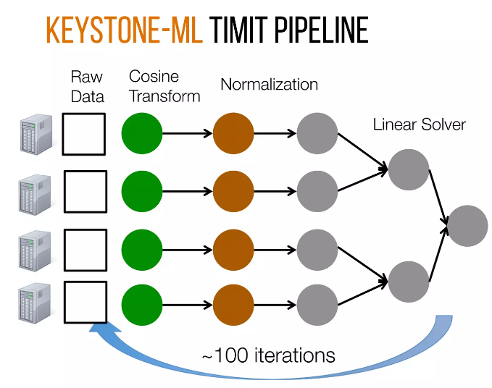
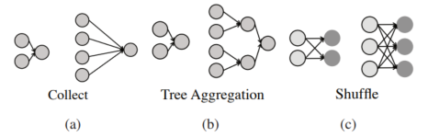
2. Background
Venkataraman, Shivaram, et al. "Ernest: Efficient Performance Prediction for {Large-Scale} Advanced Analytics." 13th USENIX Symposium on Networked Systems Design and Implementation (NSDI 16). 2016.
Performance Prediction
The main steps in building, a predictive model are
Determining the data points to collect = determining what features should be derived from the training data
Performing feature selection to pick the simplest model that best fits the data
Workload trends
Communication patterns
Numerically Intensive
Sensitive to the number of cores and bandwidth available
Long running → expensive to run on large datasets
All-to-one(collect)
Tree aggregation
Shuffle : many to many
Speech recognition pipeline
Notes:
For the background, first is about the performance prediction.
The main steps in building a predictive model are determining the data points to collect; determining what features should be derived from the training data;
and performing feature selection to pick the simplest model that best fits the data
In this paper, we look at how to perform efﬁcient performance prediction for large scale advanced analytics.
Next, we look at workload trends in large scale data analysis and how we can exploit workload characteristics for performance prediction.
As an example of an advanced analytics job, this figure shows a machine learning pipline used for Speech recognition on TIMIT dataset.
(The pipeline trains a model using kernel SVMs and the execution DAG)
This pipeline contains 3 main stages; read input data, normalize data, and build a model.
The model is then refined by generating more features and these steps are repeated for 100 iterations to achieve state-of-the-art accuracy.
Advanced analytics workloads are numerically intensive and hense are sensitive to the number of cores and bandwidth available, they are also expensive to run on large datasets.
The authors note that only a few communication patterns repeatedly occur in analytics jobs.
(a) the all-to-one or collect pattern in which data from all partitions is sent to one machine (b) the tree aggregration pattern where data is aggregated using a tree-like structure (c) the shuffle pattern where data goes from many source machines to many destinations
And for recent hardware and workload trends for large scale data analysis,
Instance types vary not only in capacity (i.e. memory size, number of cores etc.) but also in performance.
For example, we measured memory bandwidth and network bandwidth across a number of instance types on Amazon EC2.
From Figure 1 we can see that the smaller instances i.e. large or xlarge have the highest memory bandwidth available per core while Figure 2 shows that 8xlarge instances have the highest network bandwidth available per core.
The non-linear relationship between price vs. performance is not only reflected in micro-benchmarks but can also have a significant effect on end-to-end performance.
For example, we use two machine learning kernels: (a) A least squares solver used in convex optimization [37] and (b) a matrix multiply operation [75], and measure their performance for similar capacity configurations across a number of instance types.
The results (Figure 3(a)) show that picking the right instance type can improve performance by up to 1.9x at the same cost for the least squares solver.

Slide 4
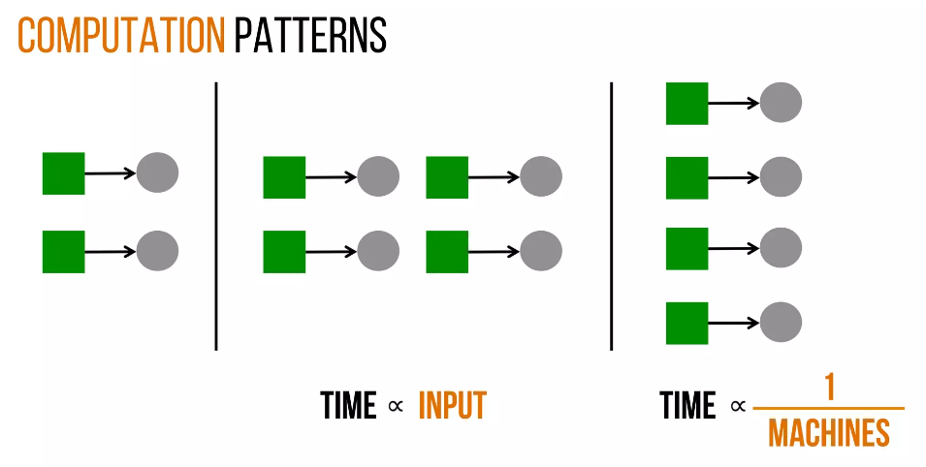
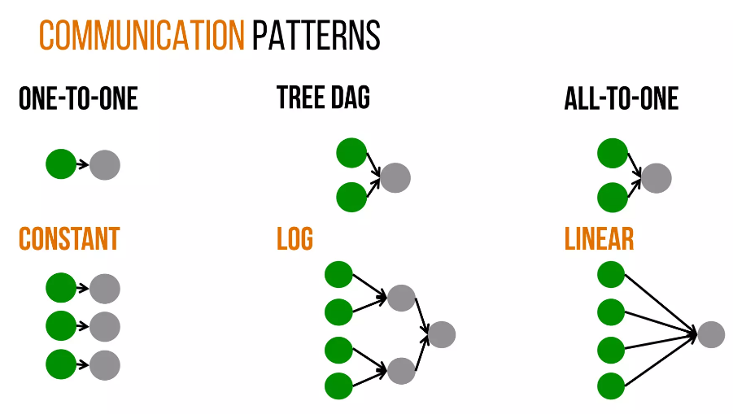
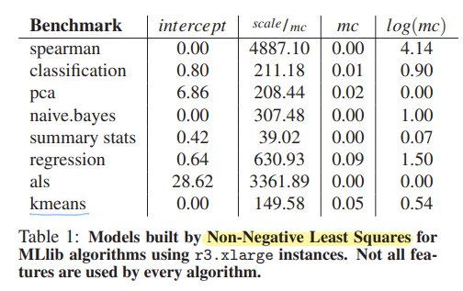
3. Modeling Advanced Analytics Jobs
Venkataraman, Shivaram, et al. "Ernest: Efficient Performance Prediction for {Large-Scale} Advanced Analytics." 13th USENIX Symposium on Networked Systems Design and Implementation (NSDI 16). 2016.
Total time
Computation
Communication
Computation patterns
Communication patterns
Basic model
$$time\text{=}θ_{0}+θ_{1}×(scale×\frac{1}{machines}\text{)+}θ_{2}×\log\left(machines\right)+θ_{3}×machines$$
Non-negative Least Squares (NNLS)
Serial Execution
Computation (linear)
Tree DAG
All-to-One DAG
Collect training data
Fit linear regression
Notes:
For this section, I will outline a model for predicting execution time of advanced analytics jobs.
The model is built using terms related to these computation and communication patterns
In computation patterns, as seen, when you double the numer of tasks, the time proportionally grows linearly as the size of input grows.
On the other hand, when you increase the number of cores(machines), the time will inversely come down.
The communication patterns are same as discussed before,
So Putting this all together, they form a simple high level performance model for such jobs, as the sum of number of terms.
The model has four components:
θ₀ – a fixed cost term representing the amount of time spent in serial execution
θ₁ x (scale/machines) – And θ₁ times the time spent in computation - to capture the parallel computation time for algorithms whose computation scales linearly with the data
θ₂ x log(machines) – to model communication patterns like aggregation trees
θ₃ x machines - to capture the all-to-one communication pattern and fixed overheads like scheduling / serializing tasks.
The goal is to find the values of θ₀..θ₃ that best fit the training data
Then one thing you might say is is this model good enough and cover all spark jobs,
So they used non-negative least squares (NNLS) solver to find the model that best fits the training data.
From the table we can see two main characteristics: (a) that not all features are used by every algorithm and (b) that the contribution of each term differs for each algorithm
Now such a model formulation is defined,
** the next step is to collect some training data and then we can use some off-the-shelf libraries in order to fit the model that they are going to use for the system

Slide 5
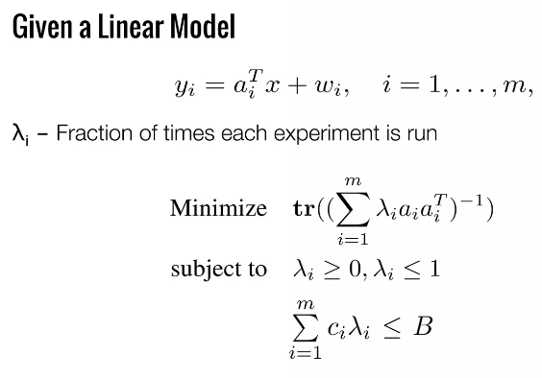
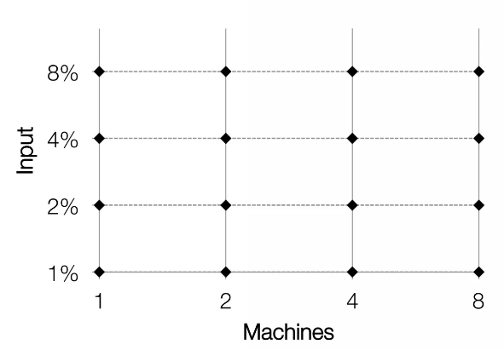
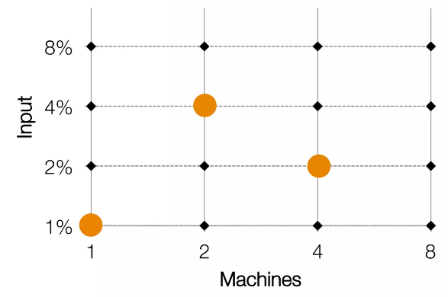
Venkataraman, Shivaram, et al. "Ernest: Efficient Performance Prediction for {Large-Scale} Advanced Analytics." 13th USENIX Symposium on Networked Systems Design and Implementation (NSDI 16). 2016.
3. Modeling Advanced Analytics Jobs
Data Collection
Optimal Experiment Design
Minimizing the time spent on collecting training data while achieving good enough accuracy
2 variables : input size, number of machines
Form a Grid of input, machines
A statistical technique that can be used to minimize the number of experiment runs required
Lower variance ⇒ Better model
Bound total cost
http://cvxr.com/cvx/
Use off-the-shelf solver (CVX)
Associate cost with each experiments
Baseline : Greedy approach = Cheapest configurations first ⇒ not good
Notes:
The next step is to collect training data points for building a predictive model.
One of the main challenges in predictive modeling is minimizing the time spent on collecting training data while achieving good enough accuracy
If you look at the model, there are 2 variables which is input size and number of machines
So a naïve approach would be forming a grid of these 2 variables, and collect all the values at all the points in the grid
So a slightly better approach is a Greedy approach : only pick the cheapest configurations and collect training data from that -> but they found that it was not that good, and the model was inaccurate
To do some better, they get back to Statistics - they outline a scheme based on optimal experiment design, a statistical technique that can be used to minimize the number of experiment runs required.
Given this linear model,
More formally we can set λi as the fraction of times an experiment is chosen
and minimize ** the trace of the inverse of the covariance matrix:
and subject this to a constraint saying that this total set of points that we pick should still be within some budget that we have.
Actually this is a a small data problem like the number of configurations that we are usually dealing with this is on the order of like hundreds or so and we're trying to pick like five or ten of the best of them out of like hundred.
In fact there are off-the-shelf(미리 만들어 놓은) solver like CVX, where you can just encode this problem into them as like a formula and you feed it in your hundred configurations
and it'll tell you what the best configurations to use are in terms of the number of machines and input size.
so that works pretty well

Slide 6

Venkataraman, Shivaram, et al. "Ernest: Efficient Performance Prediction for {Large-Scale} Advanced Analytics." 13th USENIX Symposium on Networked Systems Design and Implementation (NSDI 16). 2016.
3. Modeling Advanced Analytics Jobs
Using ERNEST
ERNEST
Job Binary
Experiment Design
Linear Model
Time
Training Jobs
Machines
Machines, Input Size
Use few iterations for training
Notes:
Whay I have told for now on is the workflow of how you would go about using the system that this paper built called ERNEST looks something like this.
From the user side we get the job binary that they're trying to run / and some sort of grid of values (the machines and input size) that we should try for building the model itself
** and then both of these are fed into this box
** And inside this box we run a number of modules which are going to actually perform some of the actions that I described earlier in the talk
so the first action is going to be ** it's going to run experiment design try and figure out the optimal set of training data points to collect
and using those training data points it's going to launch some training jobs on a cluster to run.
** the other key point here is that we actually run only a few iterations of the job in order to collect some training data and using that we can also extrapolate how the future iterations will look
** and once we have collected this training data we then put it into a linear model
** and the output of this linear model gives us this relation with how the running time varies as we change the number of machines are the input size for our job
so this gives you an end-to-end view of how Ernest works
with that I'm going to go and talk about some of the evaluations.

Slide 7
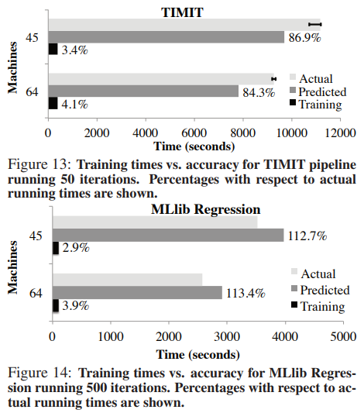
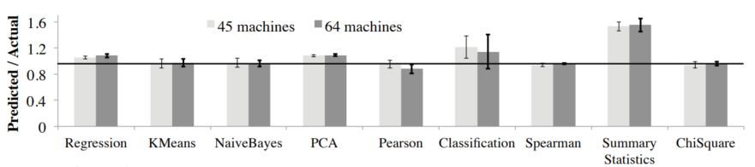
Venkataraman, Shivaram, et al. "Ernest: Efficient Performance Prediction for {Large-Scale} Advanced Analytics." 13th USENIX Symposium on Networked Systems Design and Implementation (NSDI 16). 2016.
4. Evaluation
Objectives
Prediction accuracy
Model training overhead
Choosing optimal number of instances
Importance of experiment design
Workloads : Spark Mllib, KeystoneML, Sparse GLMs, ADAM…
Model training overhead
Prediction accuracy
Metric : Predicted Time / Actual Time
9 algorithms from MLlib
Spark MLlib
Ernest efficiently handles long-running, iterative analytics jobs.
Ernest’s prediction : within 12% of the actual running time
Training time : below 4%
Ernest’s prediction : within 14%
Notes:
Next part is about evaluation and some of the use cases scenarios and also How accurate the model is and how long it takes to build the model.
They ran their model on a number of different workloads including spark Mllib and some of the Keystone-pipline.
The objectives are these 4 things.
The paper evaluate how well Ernest works by using two metrics: the prediction accuracy and the overhead of training for long-running machine learning jobs.
In experiments where to measure accuracy, or how close a prediction is to the actual job completion time,
they use the ratio of the predicted job completion time to the actual job completion time = Predicted Time/Actual Time as the metric.
They ﬁrst measured the prediction accuracy of Ernest using the nine algorithms from ML-lib.
In this experiment we configure Ernest to use between 1 and 16 machines for training and sample between 0.1% to 10% of the dataset.
We then predict the performance for cases where the algorithms use the entire dataset on 45 and 64 machines.
The prediction accuracies shown in Figure indicate that Ernest’s predictions are within 12% of the actual running time for most jobs.
One of the main goals of Ernest is to provide performance prediction with low overhead.
Figures 13 and 14 show the times taken to train Ernest and the actual running times when run with 45 or 64 machines on the cluster.
From the figures, we observe that for the regression problem the training time is below 4% of the actual running time and that Ernest’s predictions are within 14%.
For the TIMIT pipeline, the training overhead is less than 4.1% of the total running time.
** The low training overhead with these applications shows that Ernest efficiently handles long-running, iterative analytics jobs.
Ernest’s predictive model achieves less than 20% error on most of the workloads with less than 5% overhead for long running jobs.(

Slide 8
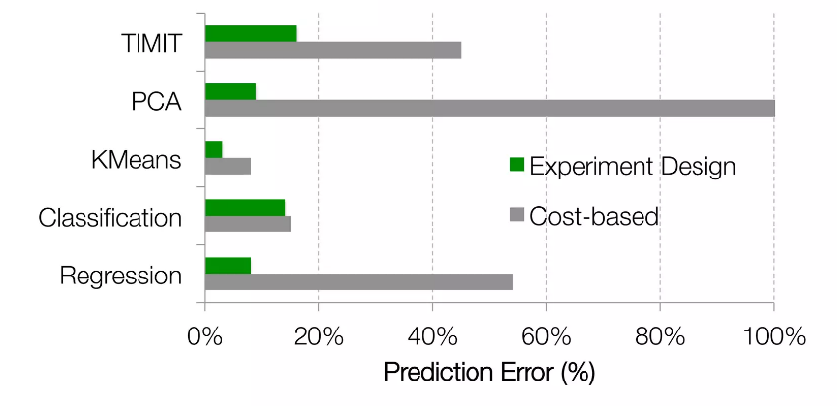
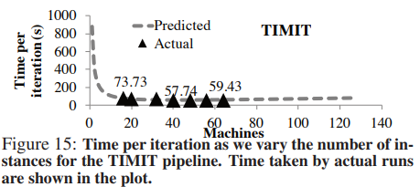
Venkataraman, Shivaram, et al. "Ernest: Efficient Performance Prediction for {Large-Scale} Advanced Analytics." 13th USENIX Symposium on Networked Systems Design and Implementation (NSDI 16). 2016.
4. Evaluation
Choosing optimal number of instances
Importance of experiment design
16
Cost = $0.35/hour ⇒ Greedy = $22.4 / Ernest = $5.6
Using the predictions from Ernest ⇒ 4x improvement in price by choosing the optimal number of instances for the speech pipeline
Given a training budget, experiment design improves accuracy by 30% ~ 50% for some workloads when compared to a cost-based approach
Notes:
When users have a fixed-time or fixed-cost budget it is often tricky to figure out how many instances should be used for a job as the communication vs. computation trade-off is hard to determine for a given workload. In here, they use Ernest’s predictions to determine the optimum number of instances.
They predict the time taken per iteration across a wide range of number of machines.
Considering that a user has a fixed time budget of 1 hour to say run 40 iterations of the TIMIT pipline,
Using Figure 15 and taking our error margin into account, Ernest is able to infer that launching 16 instances is sufficient to meet the deadline.
Given the cost is $0.35/hour, a greedy strategy of using all the 64 machines would cost $22.4, while using the 16 machines as predicted by Ernest would only cost $5.6, a 4x difference.
Then they evaluate the benefits of using optimal experiment design in Ernest.
They compare experiment design to a greedy scheme where all the candidate training data points are sorted in increasing order of cost
and they pick training points to match the cost of the points chosen in experiment design.
** For TIMIT and Regression workload, Ernest’s experiment design models perform 30% − 50% better than the costbased approach
** And when you look at PCA, the greedy the cost based approach was like missing the entire performance model and we were getting really high errors while experiment design was able to keep up within a small error for a fixed budget.

Slide 9
Venkataraman, Shivaram, et al. "Ernest: Efficient Performance Prediction for {Large-Scale} Advanced Analytics." 13th USENIX Symposium on Networked Systems Design and Implementation (NSDI 16). 2016.
5. Conclusion
Workload Trends : Advanced Analytics in the Cloud
Computation, Communication patterns affect scalability
Performance model
data
Job
Ernest : Performance predictions with low overhead
End-to-end linear model
Optimal experimental design
ERNEST
Job Binary
Experiment Design
Linear Model
Time
Training Jobs
Machines
Machines, Input Size
Use few iterations for training
Notes:
So in conclusion there's a looking at the vertical of trends today points to the fact that a large number of users are using advanced analytics in the cloud
These advanced analytics have like different communication computation patterns that severely affects scalability
and especially for more high-level users trying to understand what resource bottlenecks their workload and how to deploy their cluster in a cost-effective way is like really challenging
To address this problem they took this approach based on building a performance model with low overhead
and to do that they looked at some of the regular structure that's present in these workloads and they captured them in this linear model
and in order to reduce the amount of time spent in collecting data, they use techniques from optimal experiment design.
In this paper, we studied the problem of performance prediction and show how simple models can capture computation and communication patterns.
1. Problem : workload trends is users use advanced analytics in the cloud - large scale machine learning workload (like image classification models, speech recognition on the phone …)
2. A new approach that can accurately predict the performance of a given analytics job (large scale analytics)
Ernest, a performance prediction framework that intelligently chooses training points to provide accurate predictions with low overhead
3. It was surprising that the model was made with a simple formula and good at prediction

Slide 10
Thank You ☺

